Slide 1
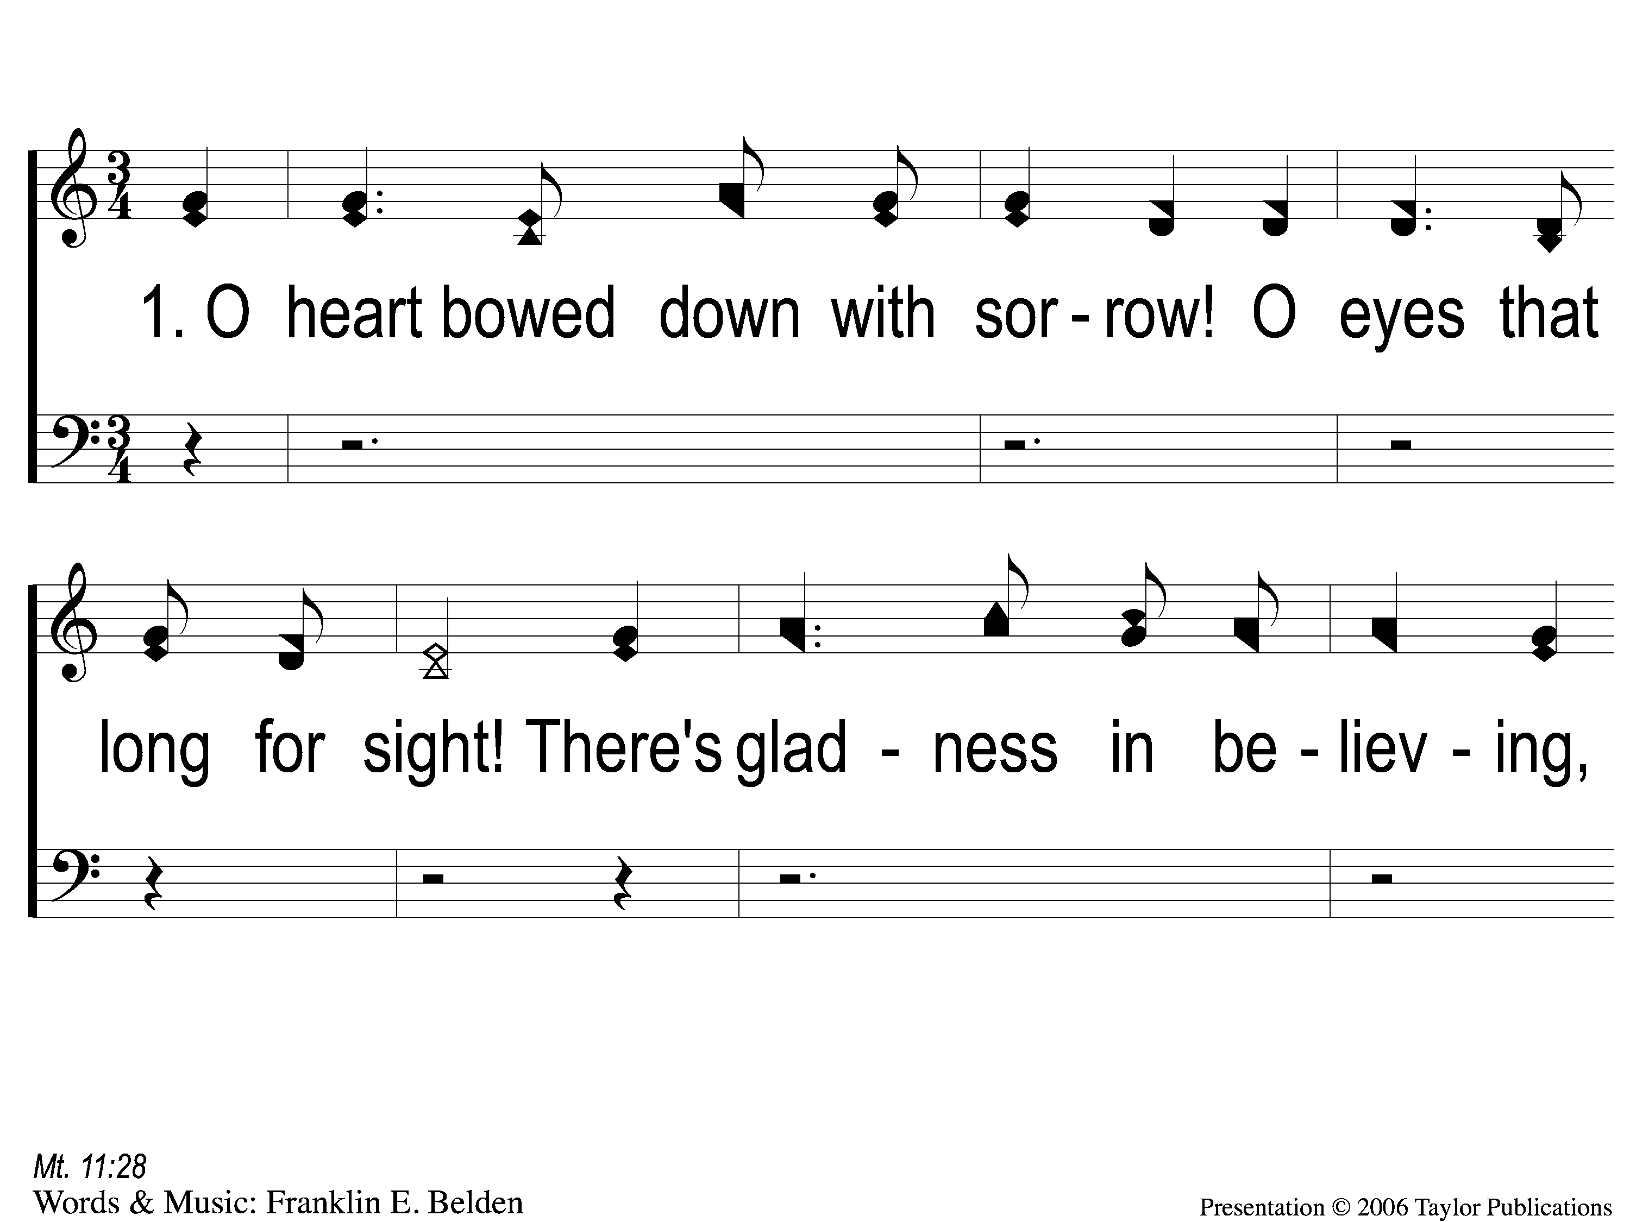
1-1 O Heart Bowed Down With Sorrow
O Heart Bowed Down With Sorrow
69

Slide 2
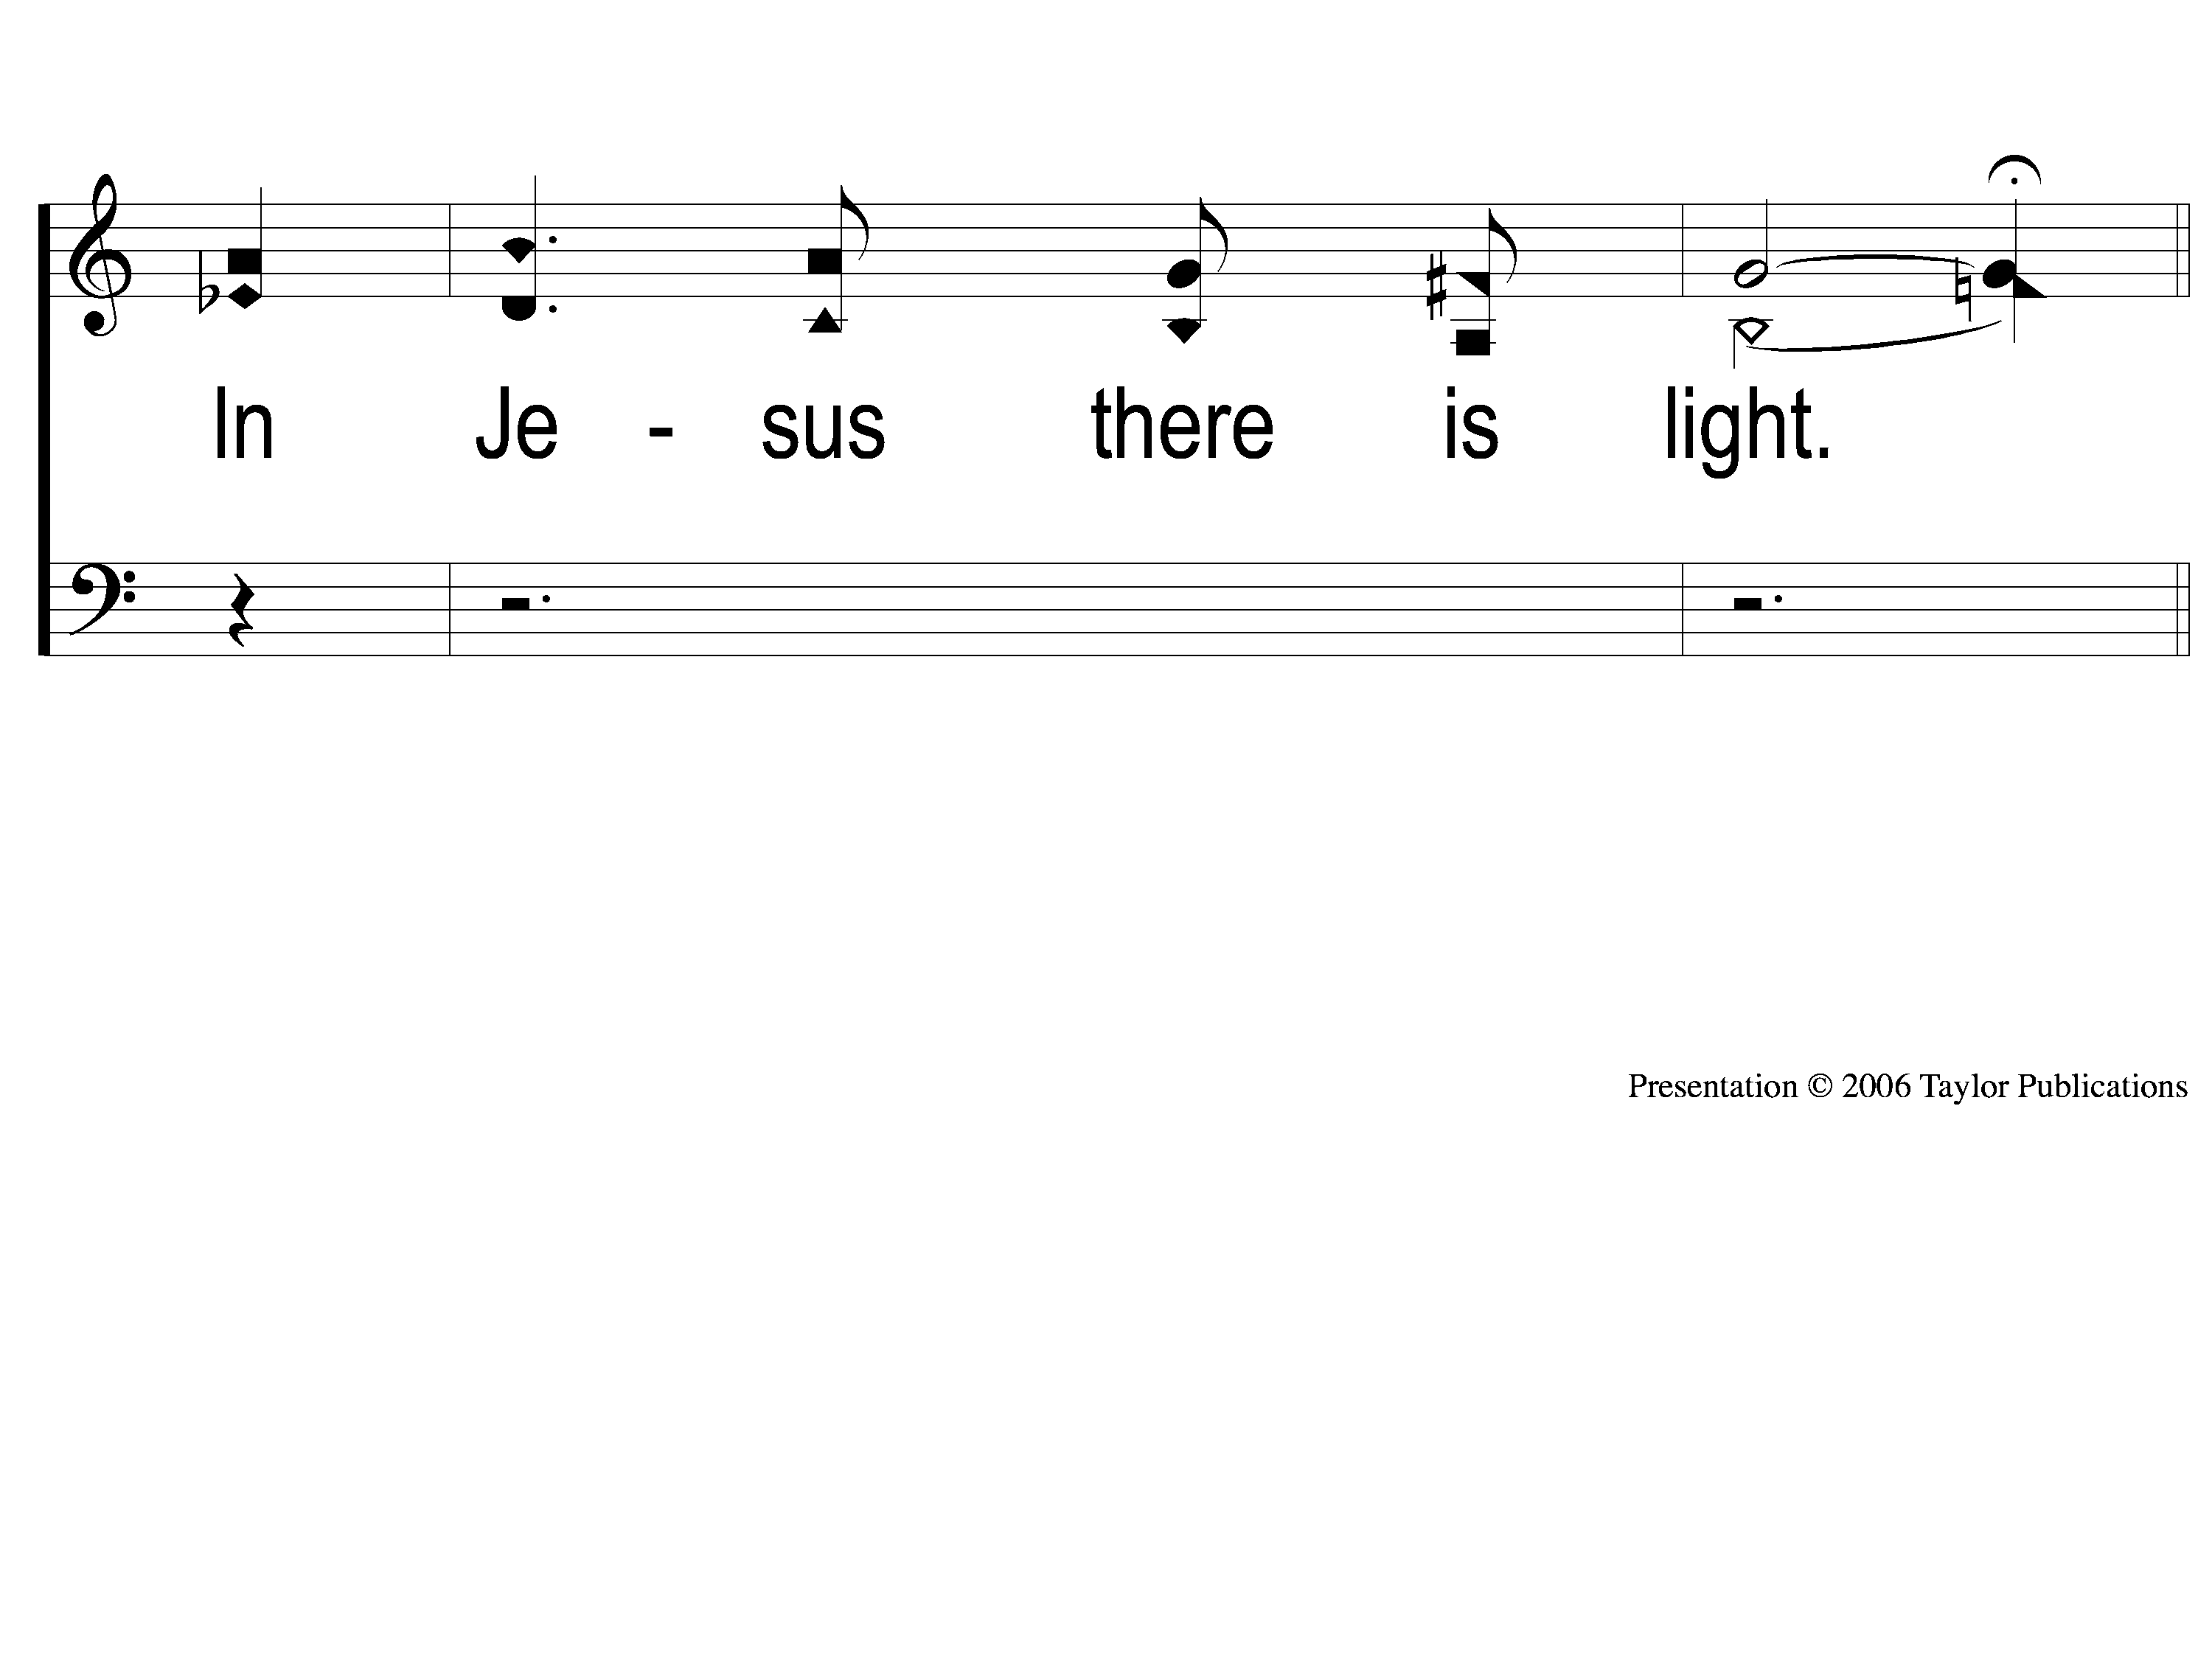
1-2 O Heart Bowed Down With Sorrow
O Heart Bowed Down With Sorrow
69

Slide 3
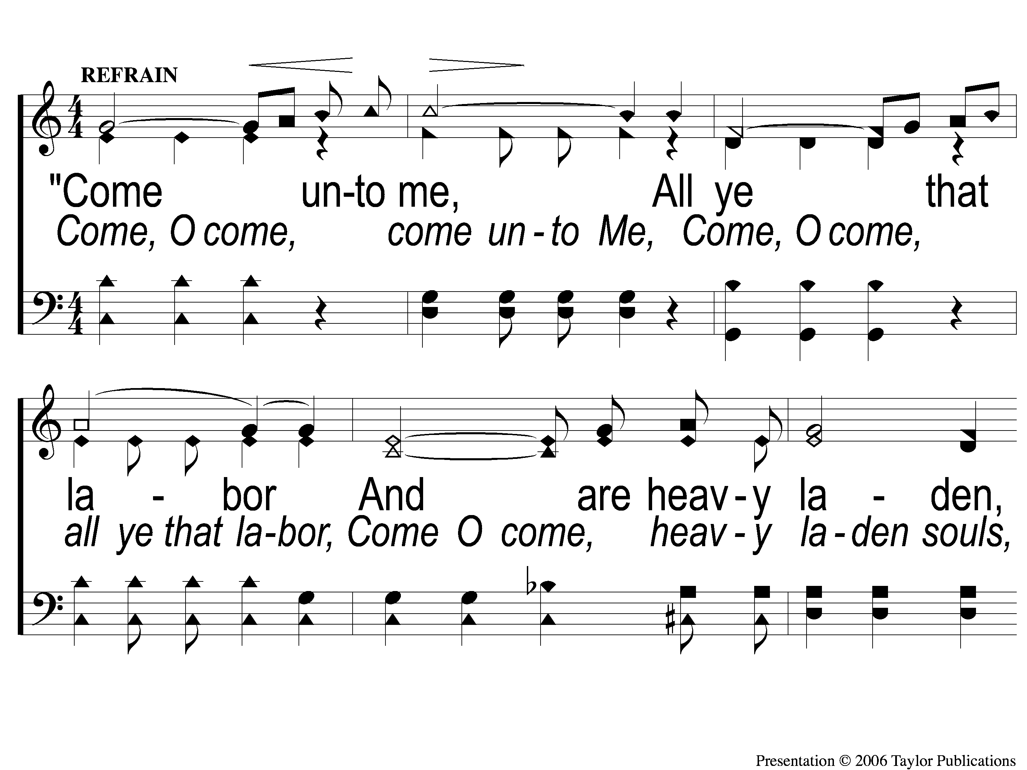
C-1 O Heart Bowed Down With Sorrow
O Heart Bowed Down With Sorrow
69

Slide 4
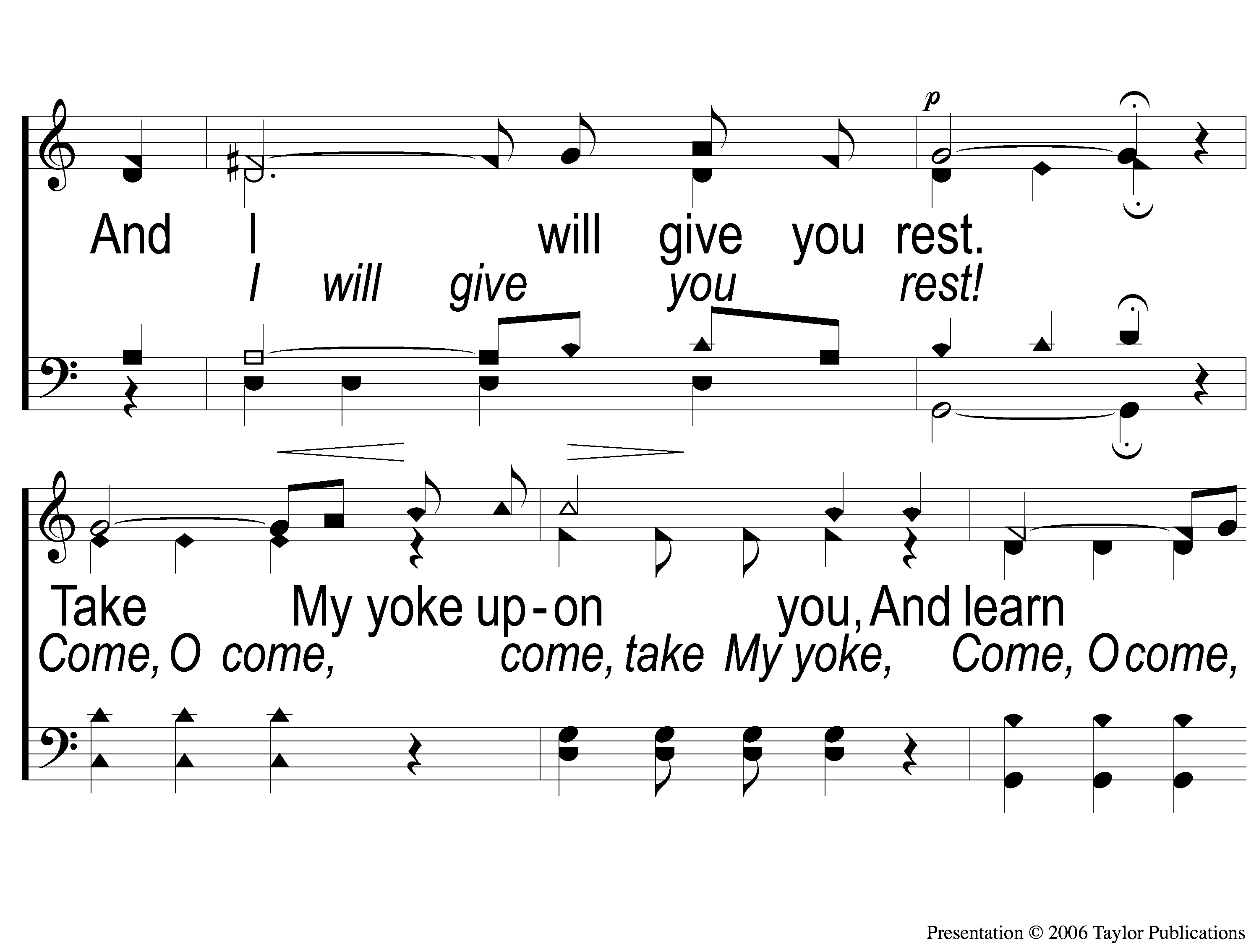
C-2 O Heart Bowed Down With Sorrow
O Heart Bowed Down With Sorrow
69

Slide 5
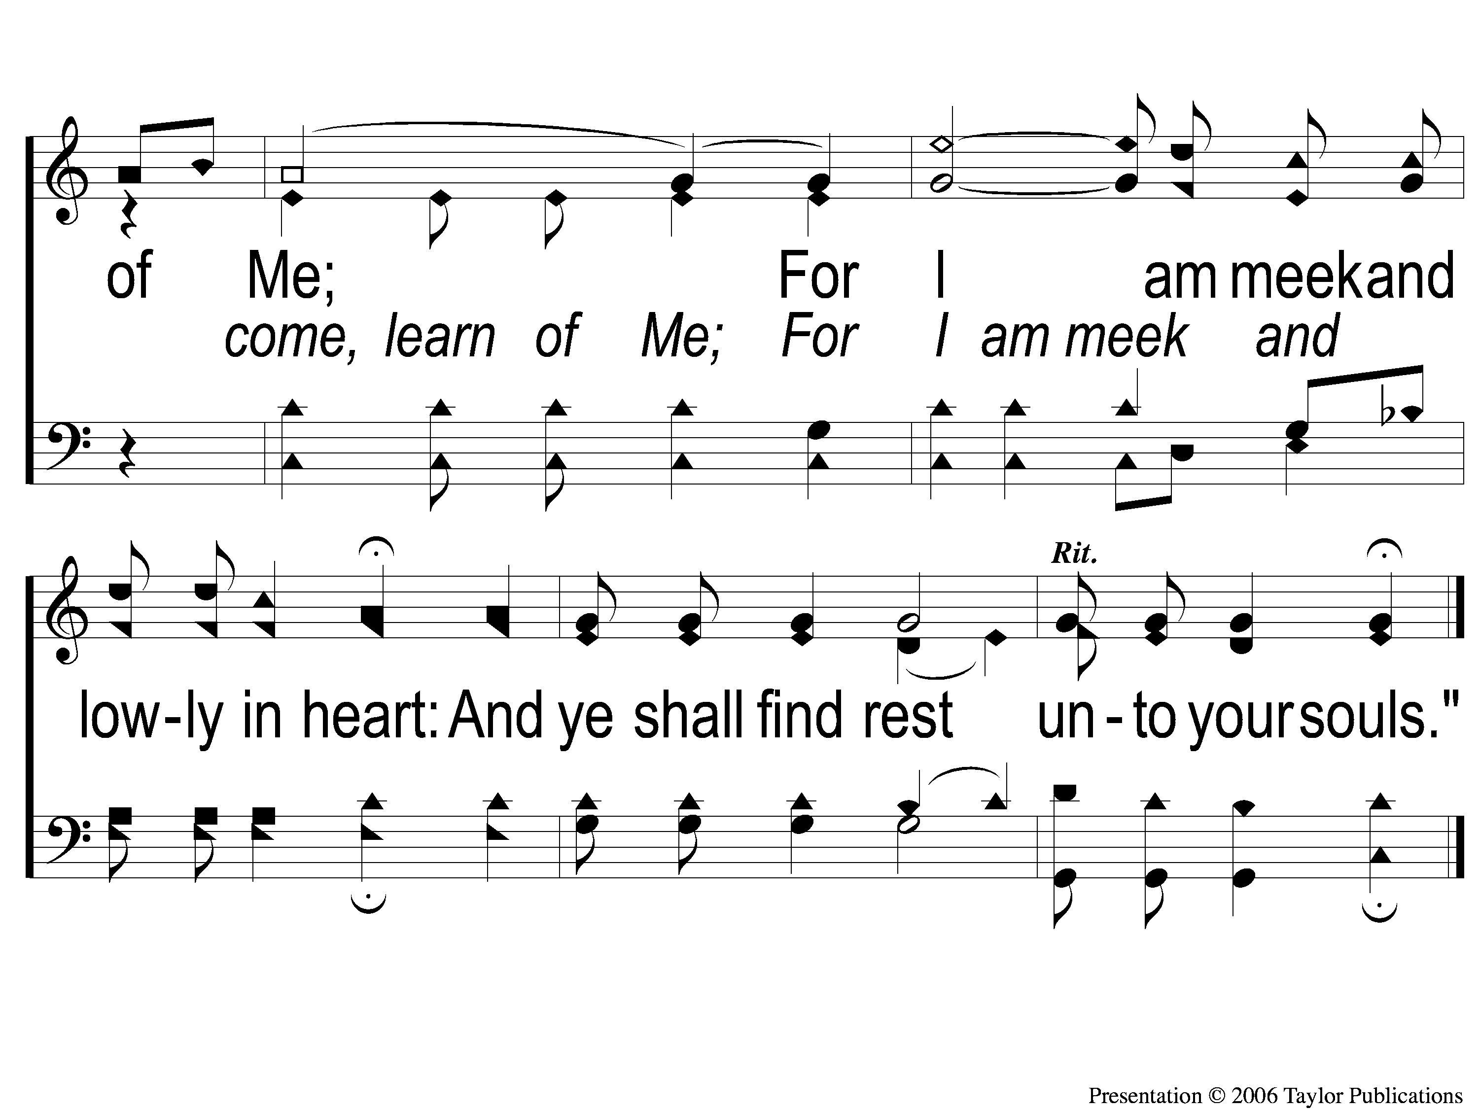
C-3 O Heart Bowed Down With Sorrow
O Heart Bowed Down With Sorrow
69

Slide 6
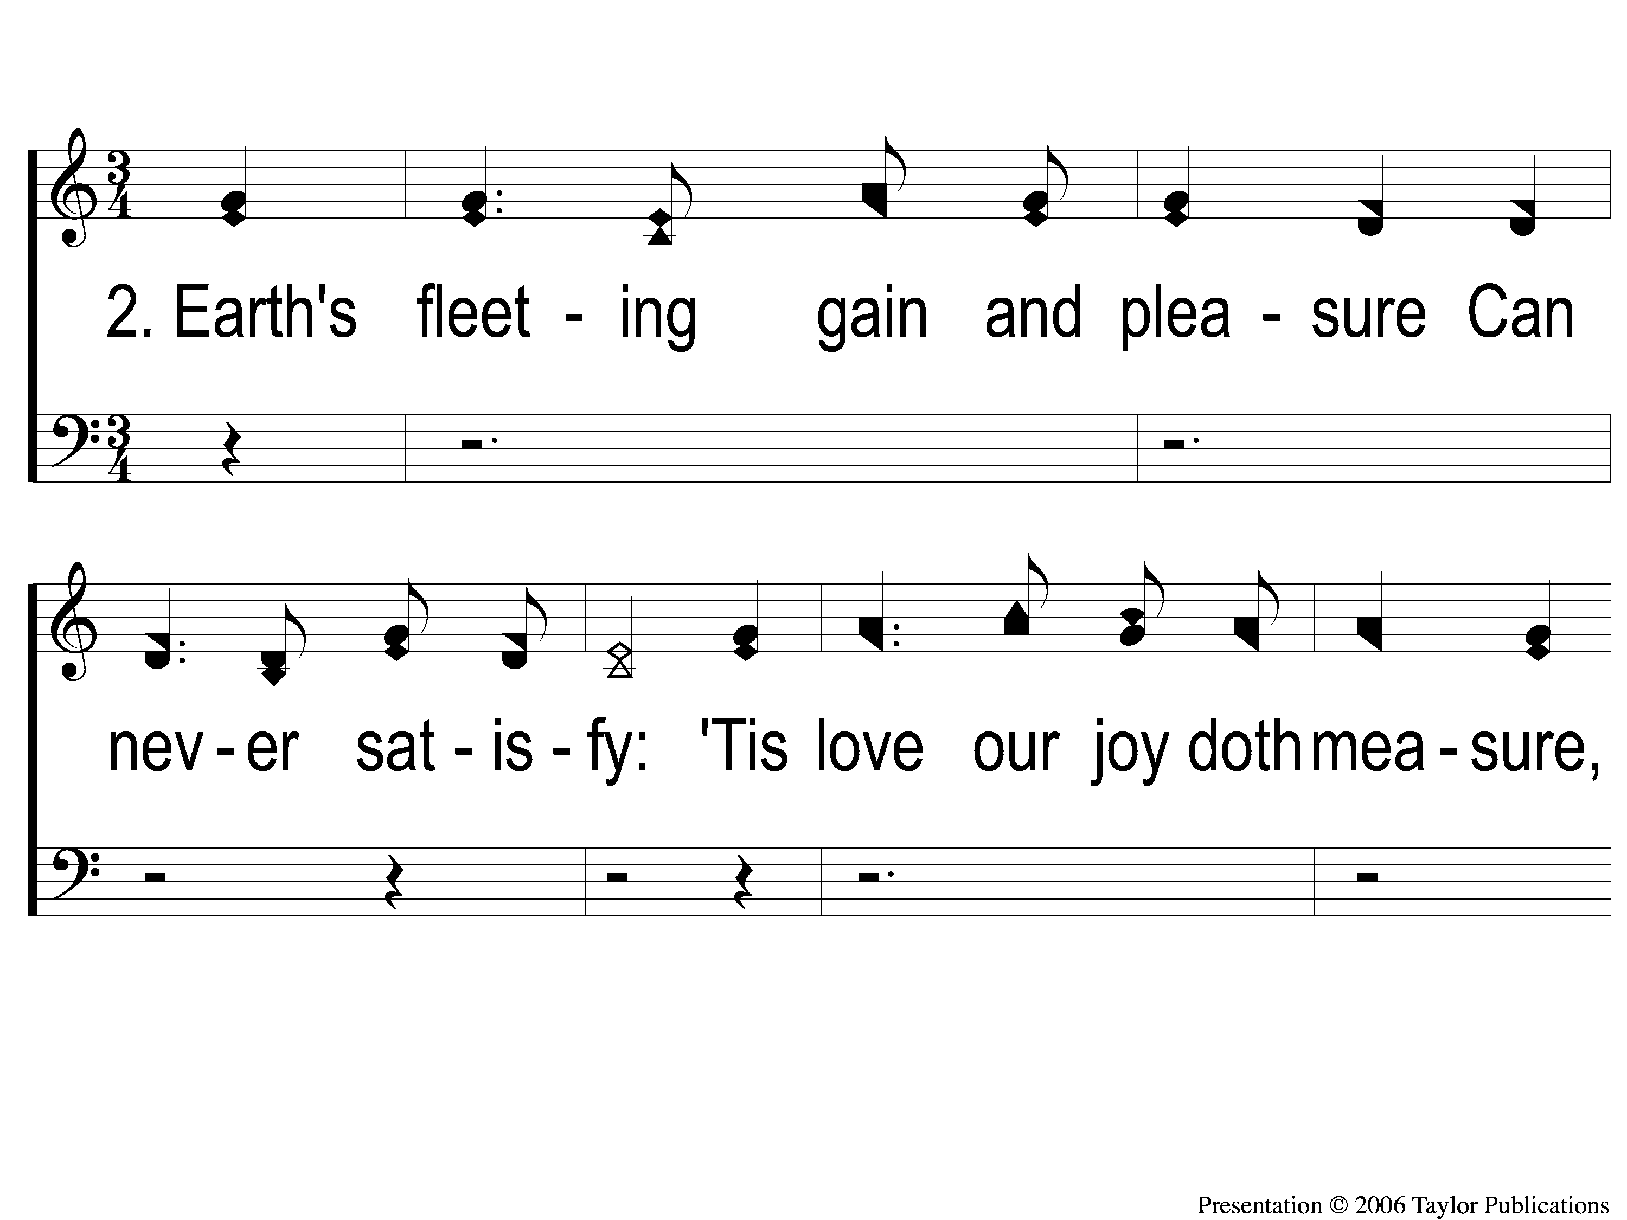
2-1 O Heart Bowed Down With Sorrow
O Heart Bowed Down With Sorrow
69

Slide 7
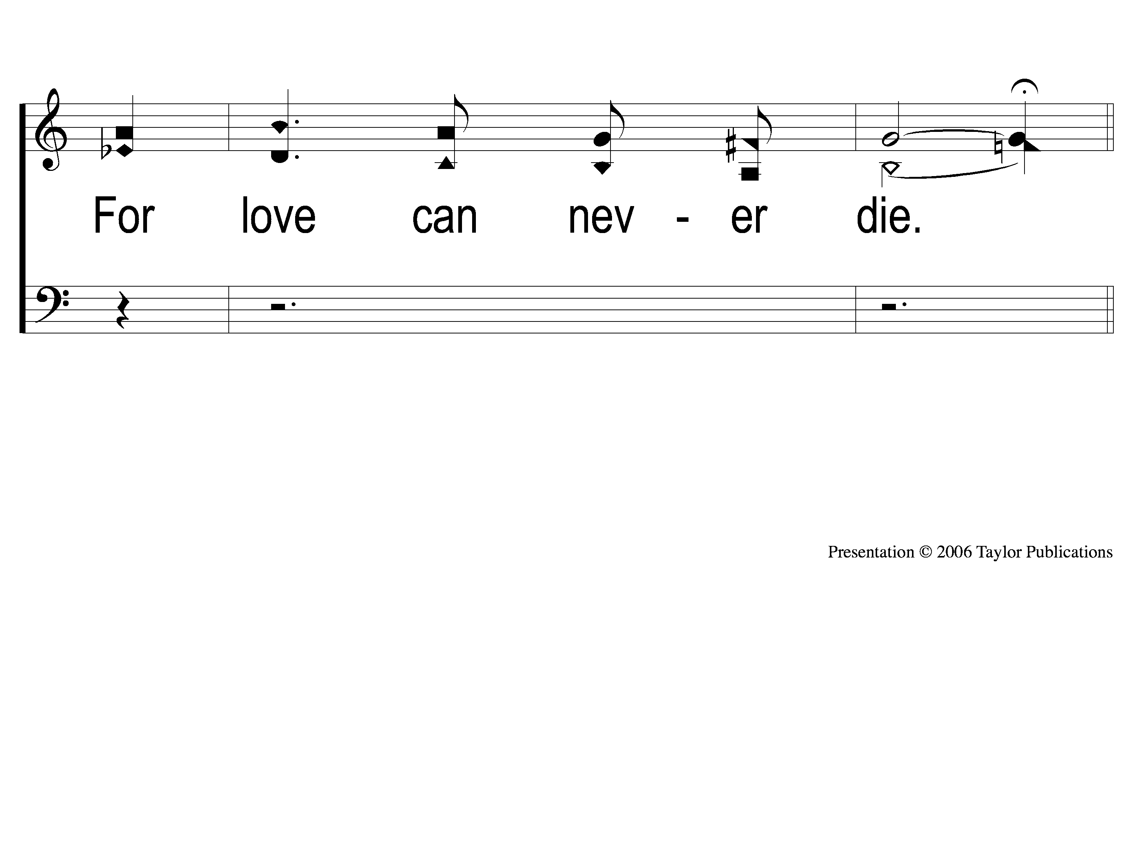
2-2 O Heart Bowed Down With Sorrow
O Heart Bowed Down With Sorrow
69

Slide 8
C-1 O Heart Bowed Down With Sorrow
O Heart Bowed Down With Sorrow
69

Slide 9
C-2 O Heart Bowed Down With Sorrow
O Heart Bowed Down With Sorrow
69

Slide 10
C-3 O Heart Bowed Down With Sorrow
O Heart Bowed Down With Sorrow
69

Slide 11
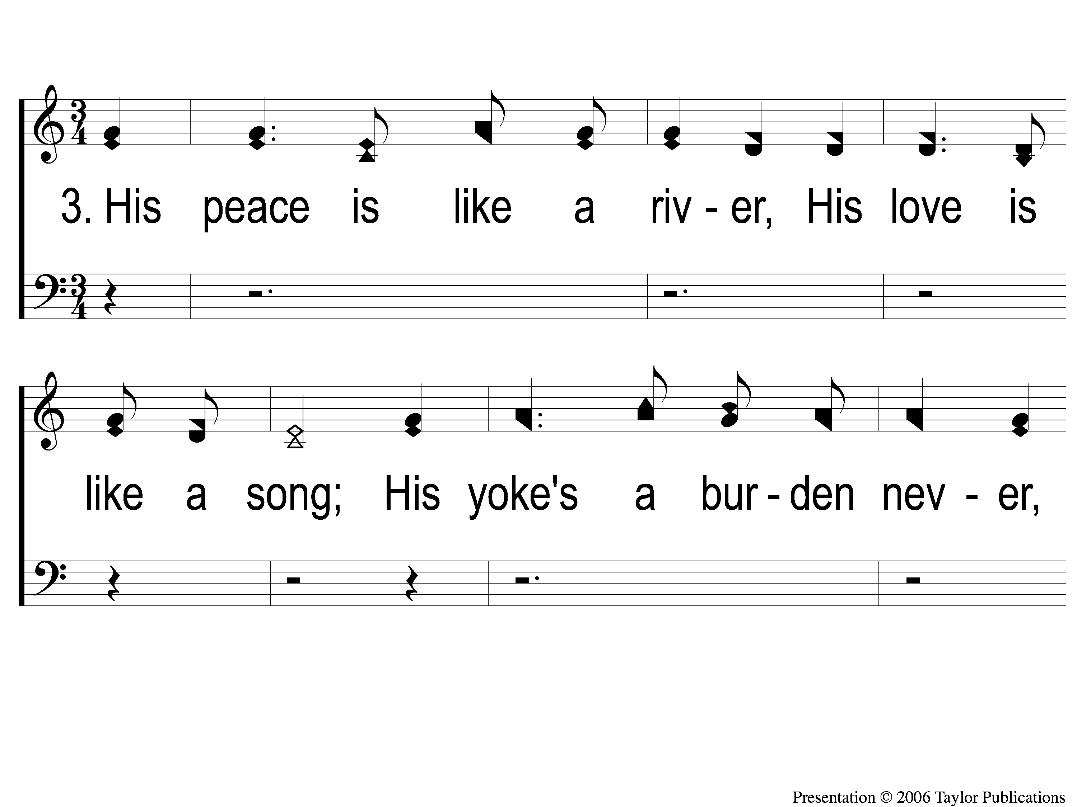
3-1 O Heart Bowed Down With Sorrow
O Heart Bowed Down With Sorrow
69

Slide 12
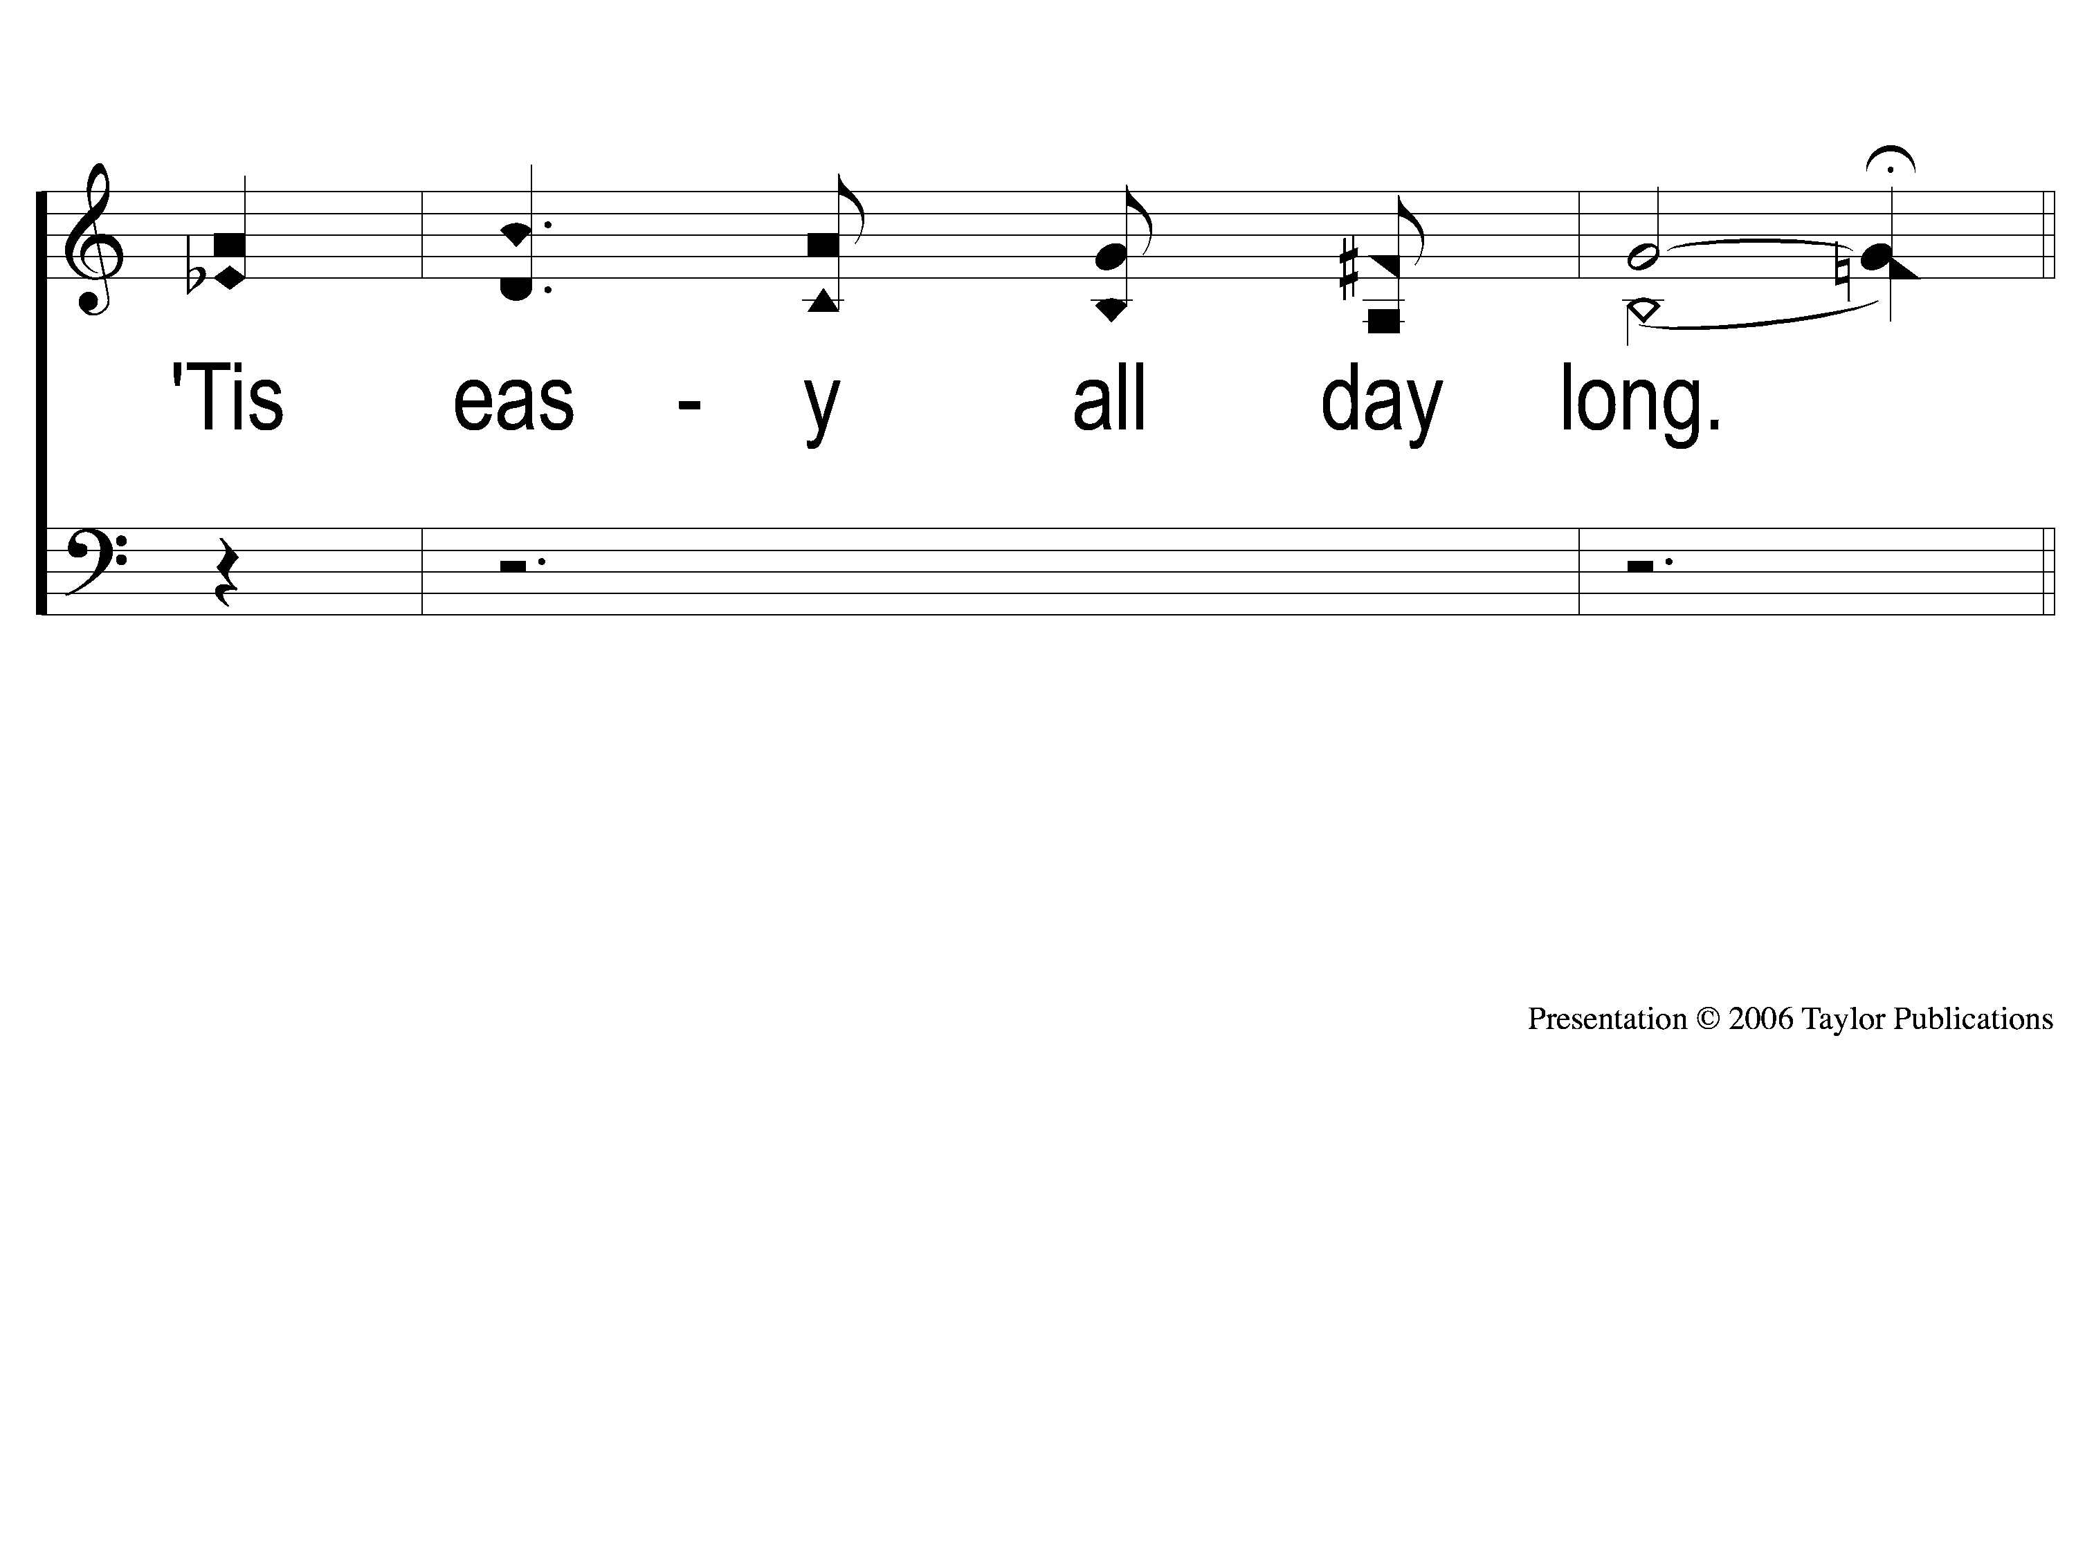
3-2 O Heart Bowed Down With Sorrow
O Heart Bowed Down With Sorrow
69

Slide 13
C-1 O Heart Bowed Down With Sorrow
O Heart Bowed Down With Sorrow
69

Slide 14
C-2 O Heart Bowed Down With Sorrow
O Heart Bowed Down With Sorrow
69

Slide 15
C-3 O Heart Bowed Down With Sorrow
O Heart Bowed Down With Sorrow
69

